Slide 1
Boolean Expression
By Rajkumar Choudhury

Slide 2
Experiment
Aim
Apparatus
Procedure
Observations
Result

Slide 3
Aim:
Learning Objective:
To simplify the Boolean expression and build the logic circuit.
Make truth table and verify the logic circuit.
To simplify the given expression and realize it using Basic Gates and Universal Gates.

Slide 4
Apparatus:
IC 7400 (NAND Gate)
IC 7402 (NOR Gate)
IC 7404 (NOT Gate)
IC 7408 (AND Gate)
IC 7432 (OR Gate)
Breadboard, Connecting Wires, Resistors, Power Supply and LEDs.

Slide 5
Theory
To design NAND-TO-NAND circuit , Convert the Boolean expression into Sum-of-Products (SOP) form and replace AND , OR Gates with NAND Gates.
To design NOR-TO-NOR circuit , Convert the Boolean expression into Product-of-Sums (POS) form and replace OR , AND Gates with NOR Gates.

Slide 6
Procedure

Slide 7
Simplify the given Boolean expression and solve it :
Using Mixed Gates
Using NAND Gates only
Using NOR Gates only
Insert the appropriate ICs into breadboard.
Make connections as made in corresponding circuit diagram.
Make truth table for all cases.
Provide the input data via the input switches and observe the output on LED and verify the truth table.

Slide 8
Observations

Slide 9
Given Boolean Expression =>
(A+BC) . (B+AC') (Distributive Law)
AB + AAC' + BBC + ABCC' (Idempotent Law)
AB + AC' + BC + ABCC' (Complement Law)
AB + AC' + BC
AB (C+C') + AC' + BC [C+C'=1]
ABC + ABC' + AC' + BC (Distributive Law)
BC (A+1) + AC' (B+1) (Absorption Law)
BC + AC'
Simplified Expression => BC + AC

Slide 10
Truth Table (Using Mixed Gates)
A | B | C | C' | BC | AC' | AC' + BC
0 | 0 | 0 | 1 | 0 | 0 | 0
0 | 0 | 1 | 0 | 0 | 0 | 0
0 | 1 | 0 | 1 | 0 | 0 | 0
0 | 1 | 1 | 0 | 1 | 0 | 1
1 | 0 | 0 | 1 | 0 | 1 | 1
1 | 0 | 1 | 0 | 0 | 0 | 0
1 | 1 | 0 | 1 | 0 | 1 | 1
1 | 1 | 1 | 0 | 1 | 0 | 1

Slide 11
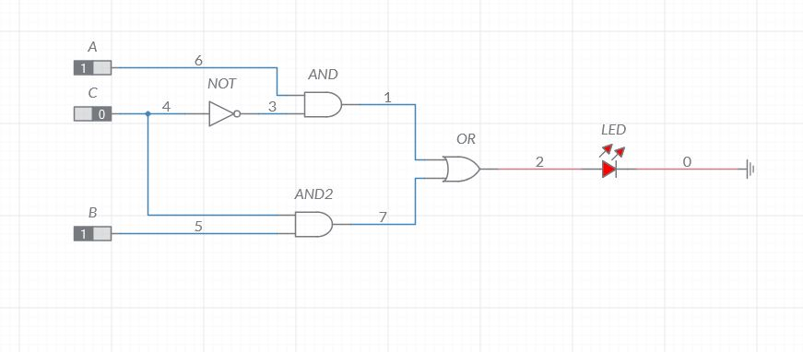
Circuit Diagram

Slide 12
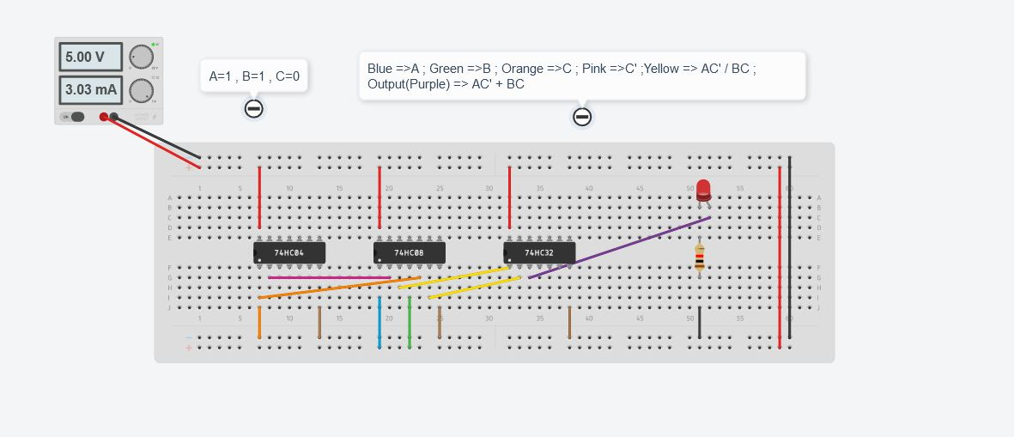
Output

Slide 13
2)Using NAND Gates Only
X = AC' + BC
Taking double complement on both sides
X = AC' + BC
Opening the inner complement using De Morgan's Law
We get,
X = AC' . BC
This expression can be represented using NAND Gates.

Slide 14
Truth Table (Using NAND Gates)
A | B | C | C' | BC | AC' | BC | AC' | AC'.BC | AC'.BC
0 | 0 | 0 | 1 | 0 | 0 | 1 | 1 | 1 | 0
0 | 0 | 1 | 0 | 0 | 0 | 1 | 1 | 1 | 0
0 | 1 | 0 | 1 | 0 | 0 | 1 | 1 | 1 | 0
0 | 1 | 1 | 0 | 1 | 0 | 0 | 1 | 0 | 1
1 | 0 | 0 | 1 | 0 | 1 | 1 | 0 | 0 | 1
1 | 0 | 1 | 0 | 0 | 0 | 1 | 1 | 1 | 0
1 | 1 | 0 | 1 | 0 | 1 | 1 | 0 | 0 | 1
1 | 1 | 1 | 0 | 1 | 0 | 0 | 1 | 0 | 1

Slide 15
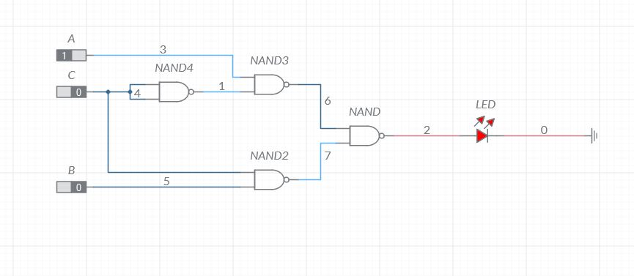
Circuit Diagram

Slide 16
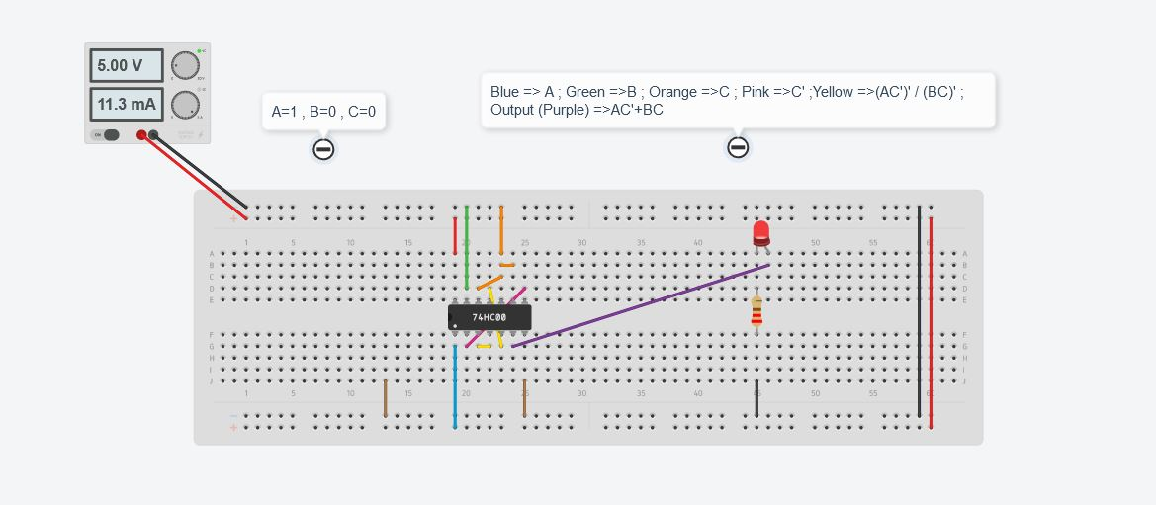
Output

Slide 17
3)Using NOR Gates Only
X = AC' + BC
Taking double complement on both sides
X = AC' + BC
Opening the complements using De Morgan's Law
X = AC' . BC
X = AC'+BC
X = A'+C + B'+C'
This expression can be represented using NOR Gates.

Slide 18
Truth Table (Using NOR Gates)
A | B | C | A' | B' | C' | A'+C | B'+C' | A’+C+ B’+C'
0 | 0 | 0 | 1 | 1 | 1 | 1 | 1 | 0
0 | 0 | 1 | 1 | 1 | 0 | 1 | 1 | 0
0 | 1 | 0 | 1 | 0 | 1 | 1 | 1 | 0
0 | 1 | 1 | 1 | 0 | 0 | 1 | 0 | 1
1 | 0 | 0 | 0 | 1 | 1 | 0 | 1 | 1
1 | 0 | 1 | 0 | 1 | 0 | 1 | 1 | 0
1 | 1 | 0 | 0 | 0 | 1 | 0 | 1 | 1
1 | 1 | 1 | 0 | 0 | 0 | 1 | 0 | 1

Slide 19
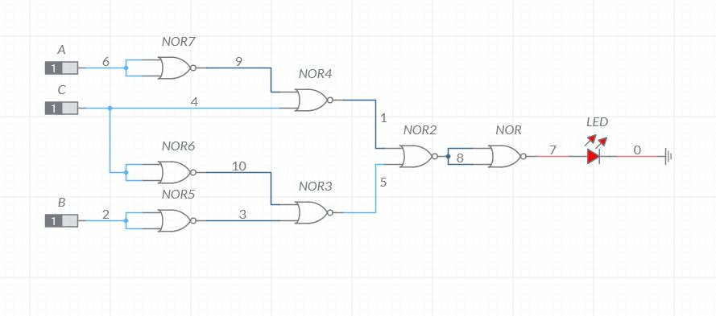
Circuit Diagram

Slide 20
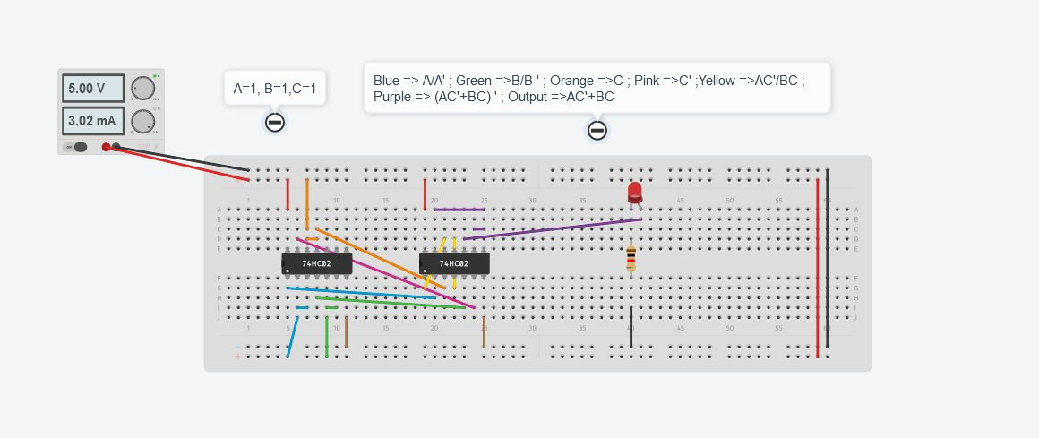
Output

Slide 21
Result
The Given Boolean Expression (A+BC) . (B+AC') is simplified to BC + AC' and verified using truth table through Mixed Gates, NAND Gates and NOR Gates.

Slide 22
Thank You

